Slide 1




AUP
By: Christina Anderson
EDTC 630

Slide 2

What is an AUP?
AUP stands for Acceptable Use Policy
The AUP is an outline of procedures/rules to inform all students and employees how all telecommunications resources should be properly used in accordance to the educational goals of the school system.
There is a separate AUP for students and teachers.
Our AUP has three main sections: procedures, acceptable uses, and unacceptable uses.

Slide 3
Why do we have an AUP?
Help make sure the telecommunications are used in a safe, legal, responsible, ethical, and efficient manner.
Not to impose restrictions but to create a safe and trusted learning environment.
To ensure the Internet is a safe learning environment.

Slide 4
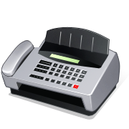


What technologies are included in our AUP?
The telecommunication technologies that are included in our AUP are: computers, e-mail, telephones, fax machines, and other wire or wireless technologies.
The Internet is also a large portion of the AUP.

Slide 5


Where can I find our AUP?
All employees signed the employee AUP when they were hired. The AUP can be found in our teacher handbook or on pages 115-120 at http://www.hcps.org/departments/docs/technology/technologyplan.pdf
All students and parents must sign the AUP brochure every school year. The student AUP is given to the students in the Policies and Procedure brochure they receive each school year.
All students and employees must sign the AUP before they use any type of telecommunication technology.

Slide 6


Consequences of not following the AUP (teachers & students)
Failure to adhere to the AUP will result in disciplinary action.
  Telecommunications use is privilege and can be revoked.
  Willingly misusing the technology can lead to serious disciplinary action and/or criminal prosecution under applicable local, state, and federal law.
  **The school system has the right to monitor equipment, systems and network traffic at any time. They reserve the right to audit networks and systems to ensure compliance with the AUP.**

Slide 7
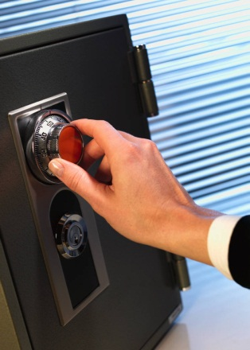
Teacher AUP Procedures
(for the use of telecommunication resources)
Telecommunication technology should be used for only school or job related purposes.
Employees should observe all copyright laws.
Nothing is private. School officials can and will search email or data on all district computers at any time.
Keep passwords safe. Never share passwords.

Slide 8
Teacher AUP Procedures
(for the use of telecommunications resources)
Never let students work on the Internet without supervision.
Damage caused by intentional misuse will be charged to the employee.
Do not transmit credential information about students without proper safeguards.
Cannot download or install software.
Demonstrate responsible and ethical behavior when using the school systems equipment.
Only school email is authorized for use on the school computers.

Slide 9

Teacher Acceptable Uses
Using equipment for school/job related activities
Showing respect and taking care of equipment
Observing all copyright laws
Communicating with others in a courteous and professional manner
Reporting to principal of any e-mail message which threatens to endanger the safety of students, employees, or other persons

Slide 10

Teacher Unacceptable Uses
Transmitting profane, obscene, pornographic, or other related inappropriate material that would violate the Hate/Bias Policy
Transmitting any threatening material
Creating, transmitting, or introducing computer viruses
Using the technology to incur unauthorized financial obligation to the school system by purchasing products/services over the Internet

Slide 11
Student Acceptable Uses
Accessing and exchanging of information to promote research and instruction for educational purposes only
Showing respect and taking care of equipment
Practicing responsible, ethical, and legal behavior, including observing the copyright laws
Being polite and using appropriate language
Monitoring time online in consideration of others

Slide 12

Student Unacceptable Uses
They are the same as the teacher ones, but here are the additional ones for students.
Revealing personal information, address, home phone numbers
Accessing chat rooms or messaging applications
To acquire term papers or any other prepared projects or reports
Scanning in student’s own image or the image of other students

Slide 13

Tips for implementing student AUP in your classroom
Have a conversation with your students about what the AUP is and the consequences of not following the AUP
Always monitor students when they are using the Internet
Educate your students about Internet safety and rules about using the Internet
Teach students the copyright laws and how to cite any sources they use
Review any websites in advance before using them with your students to make sure they are appropriate

Slide 14


Tips for following the teacher AUP
All technologies must be used for only work related activities (phone, Internet)
Never share passwords. Keep passwords in a safe place
Emails must be work related and do not use personal email at work
Keep all personal information private (phone numbers, address)
Follow all copyright laws
Do not download or install any software without permission
If you are unsure about anything ask first!

Slide 15
References
Harford County Public Schools Technology Plan. (2011). Acceptable use policy for students. Retrieved from http://www.hcps.org/departments/docs/technology/technologyplan.pdf
Harford County Public Schools Technology Plan. (2011). Acceptable use policy for teachers. Retrieved from http://www.hcps.org/departments/docs/technology/technologyplan.pdf

