Slide 1
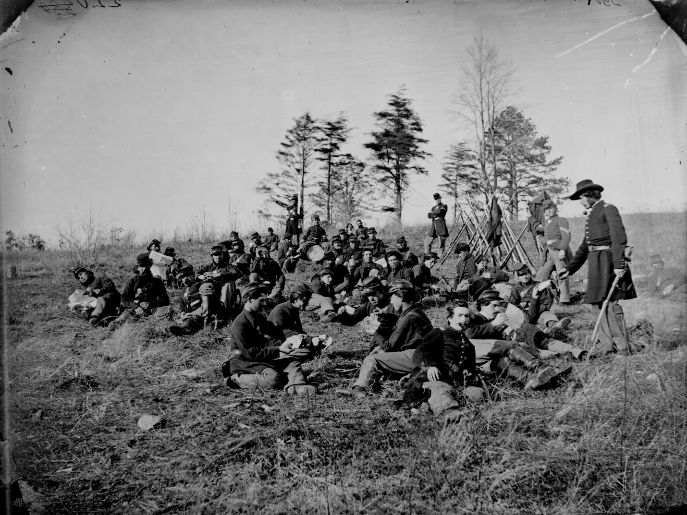
Gettysburg Address
Christina Anderson
EDTC 620
Image Source: http://www.archives.gov/research/military/civil-war/photos/images/civil-war-002.jpg

Slide 2
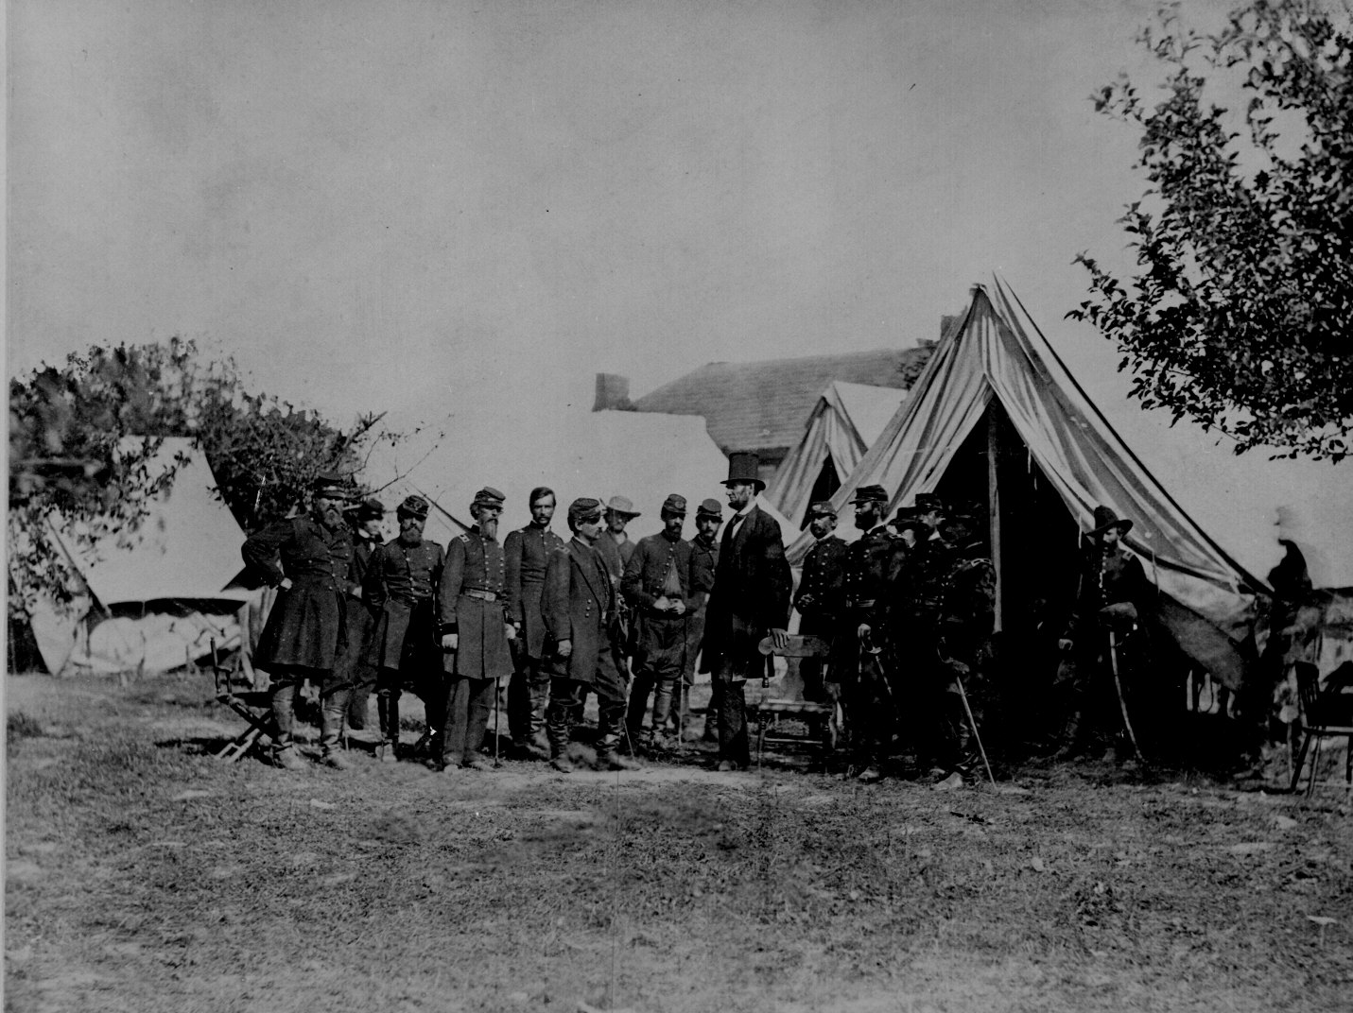
Four score and seven years ago
Image source: http://www.archives.gov/research/military/civil-war/photos/images/civil-war-021.jpg

Slide 3
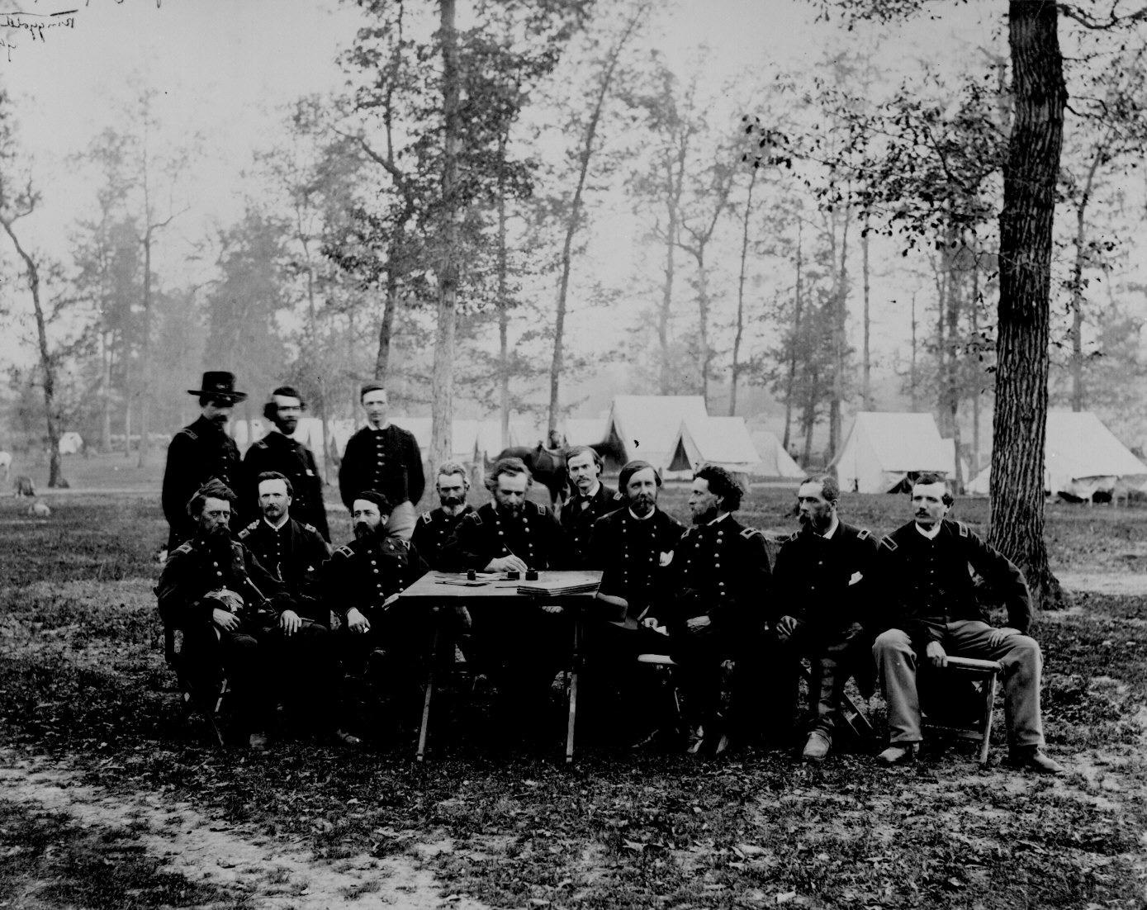
Our fathers brought forth on this continent a new nation,
Image source: http://www.archives.gov/research/military/civil-war/photos/images/civil-war-022.jpg

Slide 4
Conceived in liberty and dedicated to the proposition that

Slide 5
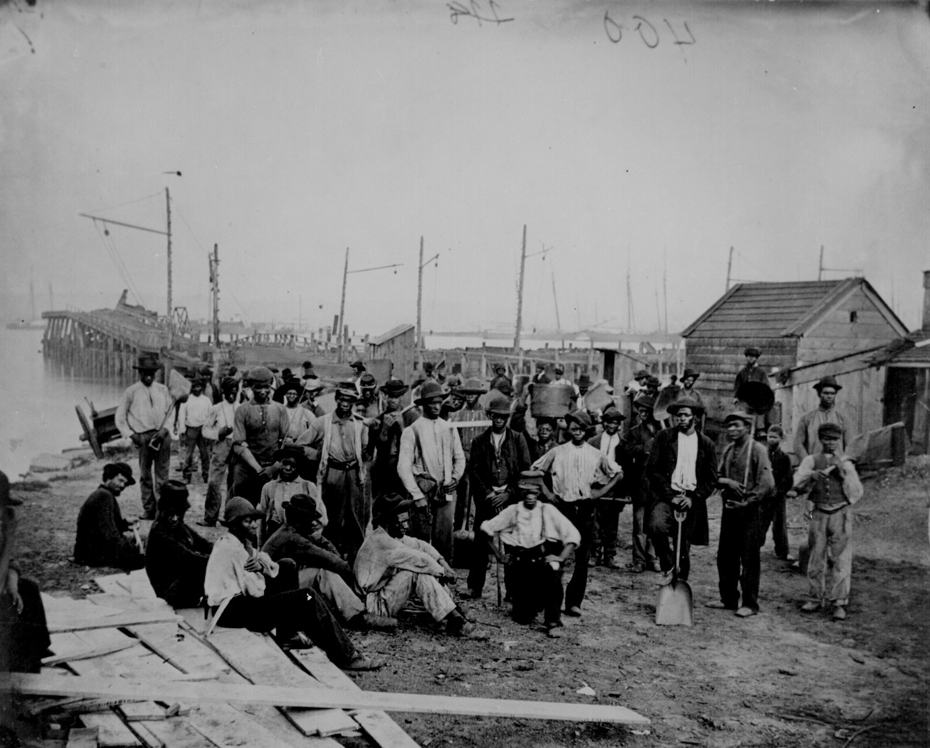
“all men are created equal.”
Image Source: http://www.archives.gov/research/military/civil-war/photos/images/civil-war-014.jpg

Slide 6
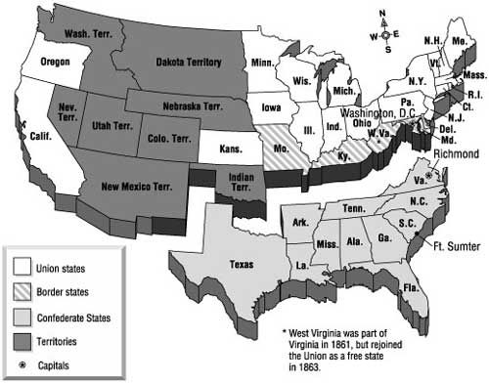
Now we are engaged in a great civil war,
Image Source: http://thomaslegion.net/sitebuildercontent/sitebuilderpictures/american-civil-war-map.jpg

Slide 7
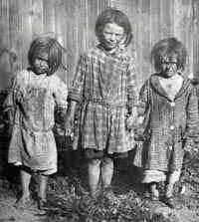
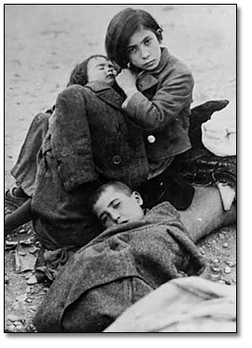
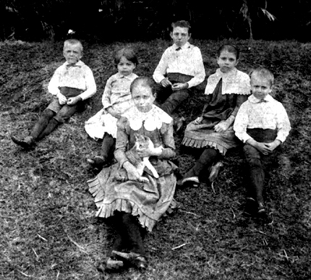
testing whether that nation or any nation so conceived and so dedicated can long endure.
Image Source: (Left to Right)
http://www.archives.gov.on.ca/english/on-line-exhibits/spain/pics/f126_33_3kids_270.jpg
http://hmscivilwarproject.wikispaces.com/file/view/Children_in_the_1800s.jpg/75220329/Children_in_the_1800s.jpg
http://nanakai.squarespace.com/storage/Grove%20Farm%20kids.jpg?__SQUARESPACE_CACHEVERSION=1293478728828

Slide 8
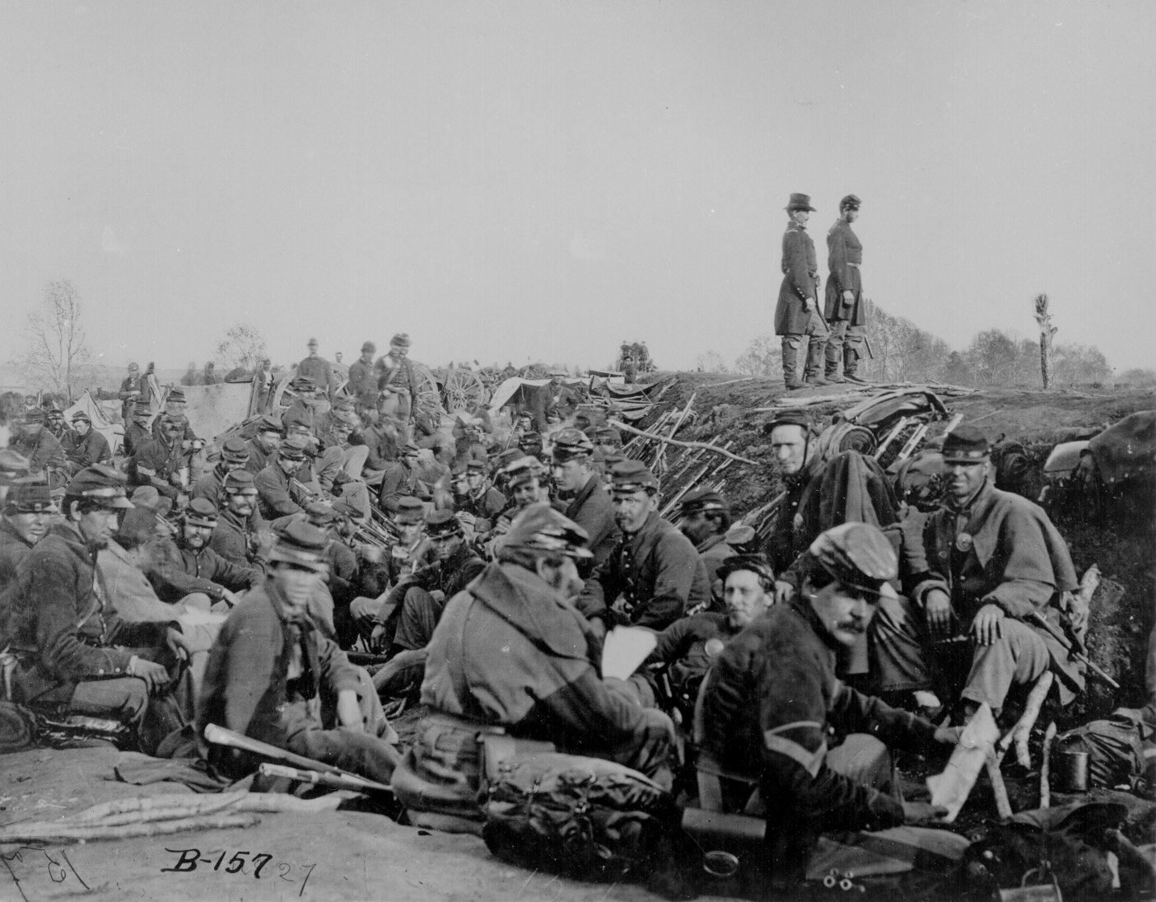
We are met on a great battlefield of that war.
Image Source: http://www.archives.gov/research/military/civil-war/photos/images/civil-war-115.jpg

Slide 9
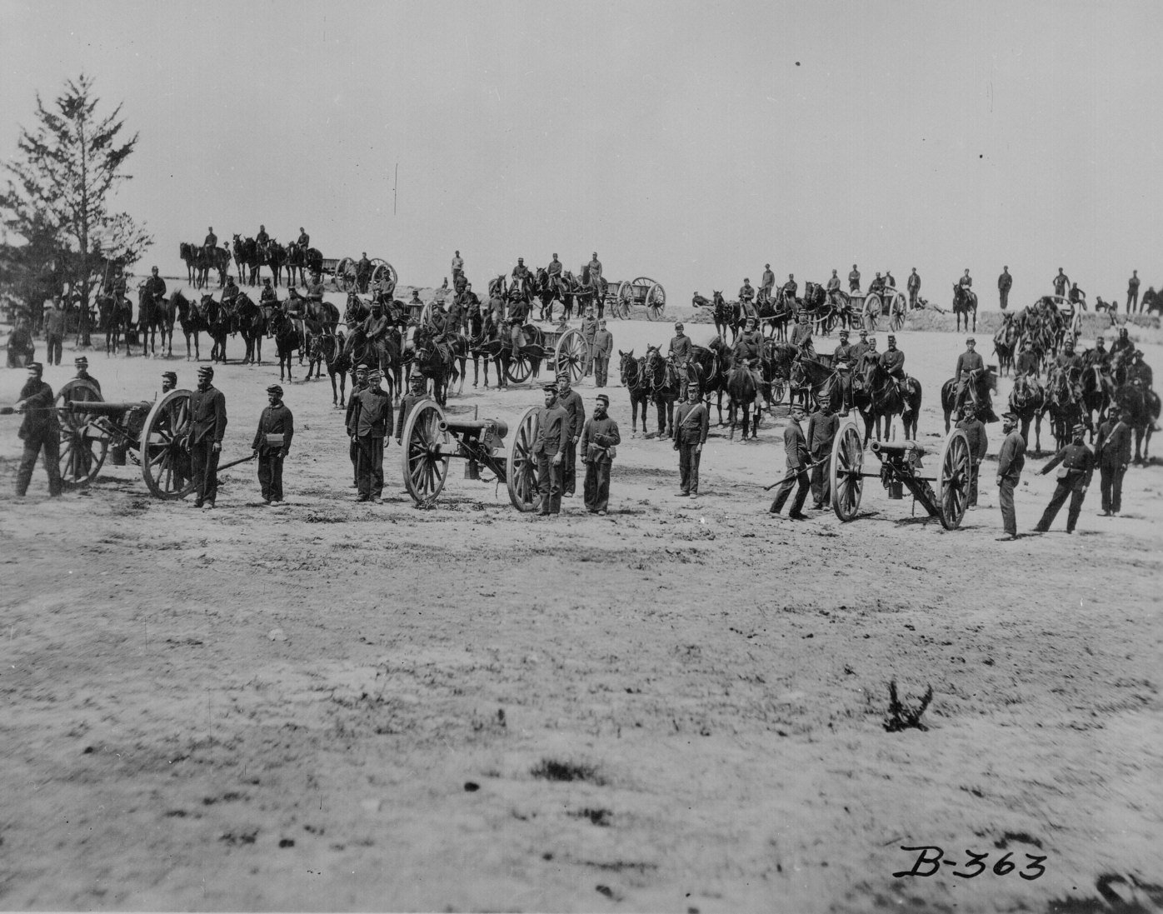
We have come to dedicate a portion of that field
Image Source: http://www.archives.gov/research/military/civil-war/photos/images/civil-war-008.jpg

Slide 10
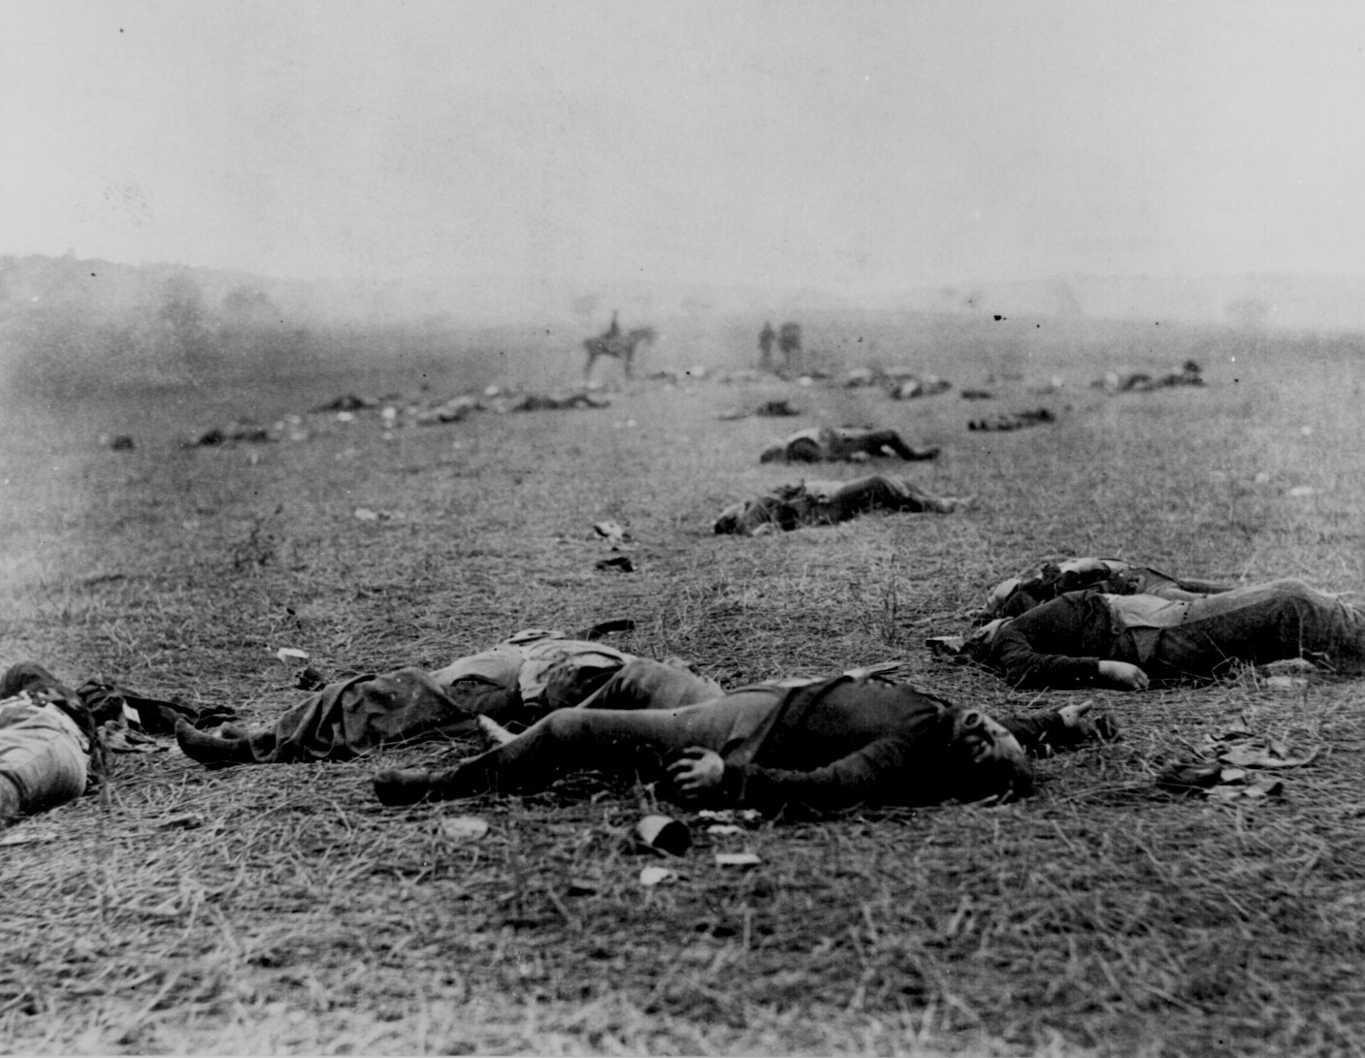
as a final resting-place
Image source: http://www.archives.gov/research/military/civil-war/photos/images/civil-war-099.jpg
for those who here gave their lives that

Slide 11
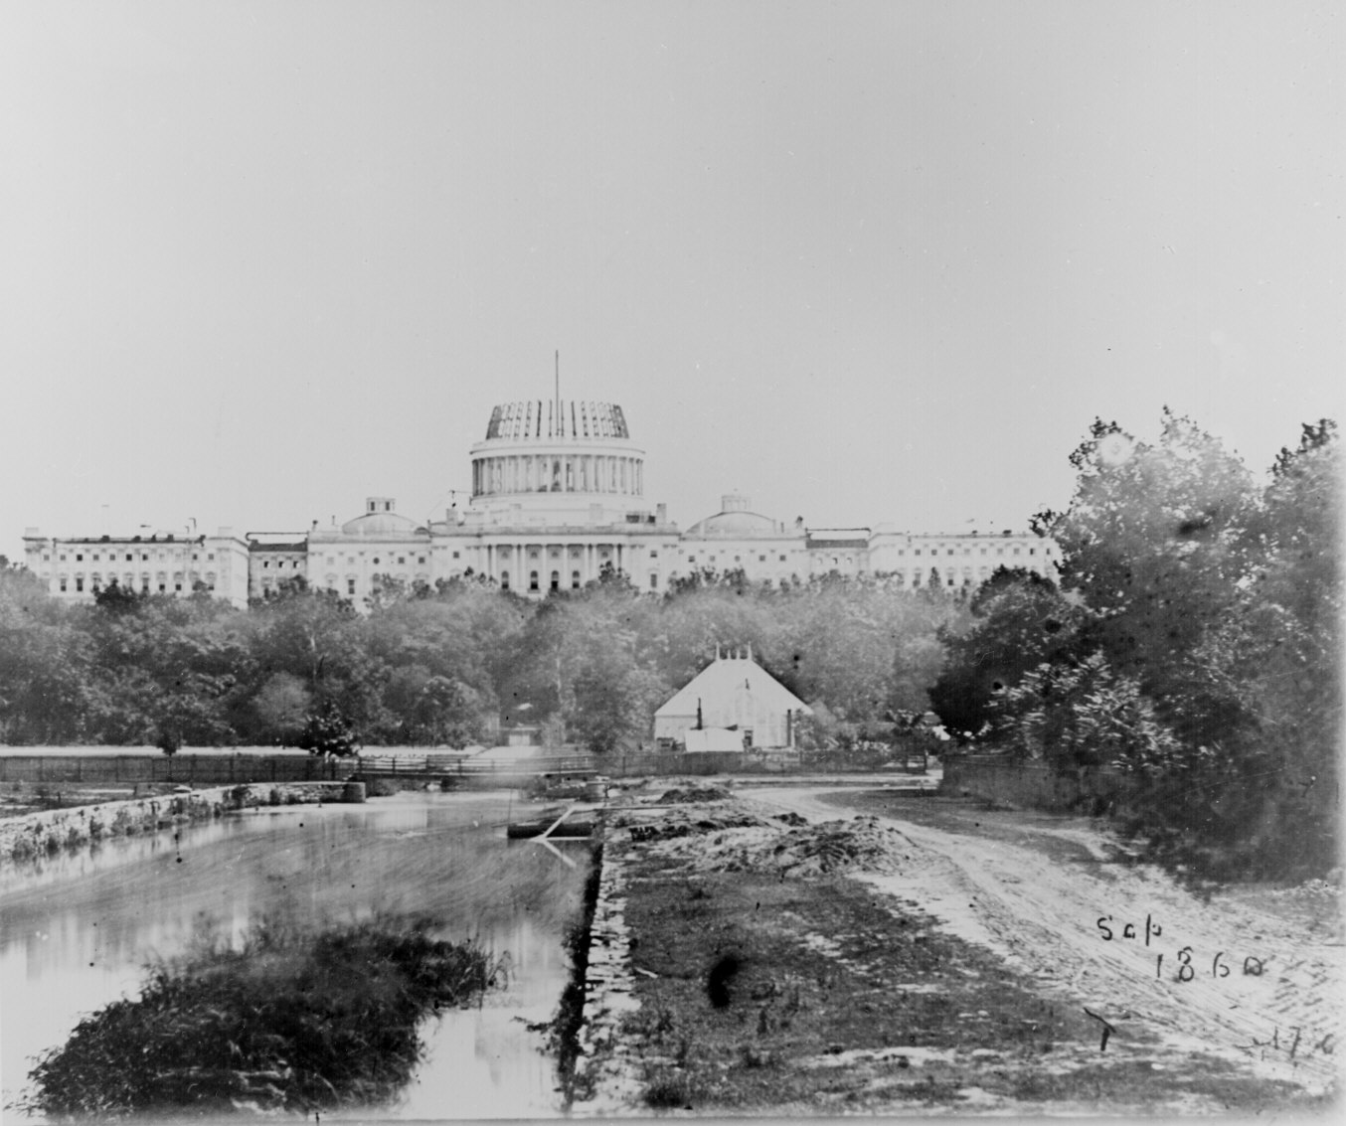
that nation might live.
Image Source: http://www.archives.gov/research/military/civil-war/photos/images/civil-war-120.jpg

Slide 12
It is altogether fitting and proper
that we should do this.
But in a larger sense,
we cannot dedicate,
we cannot consecrate,

Slide 13
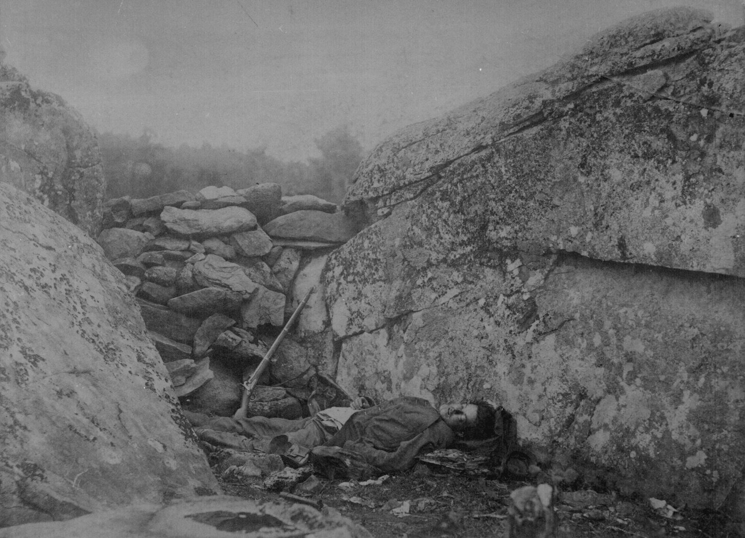
Image source: http://www.archives.gov/research/military/civil-war/photos/images/civil-war-098.jpg
we cannot hallow this ground.

Slide 14
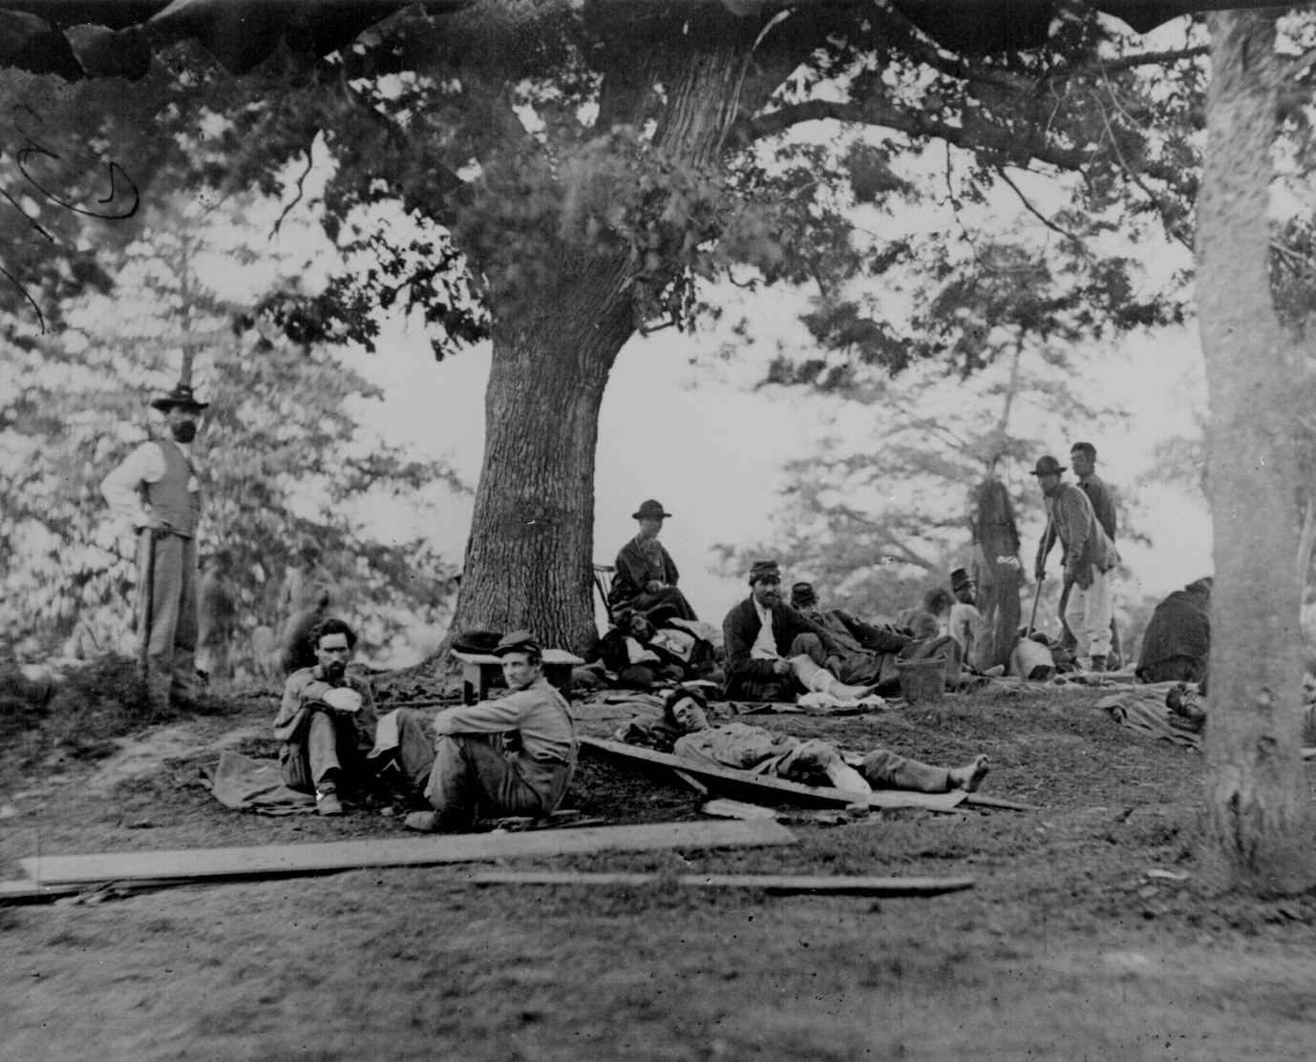
The brave men, living and dead who struggled here have consecrated it far above our poor power to add or detract.
Image Source: http://www.archives.gov/research/military/civil-war/photos/images/civil-war-035.jpg

Slide 15
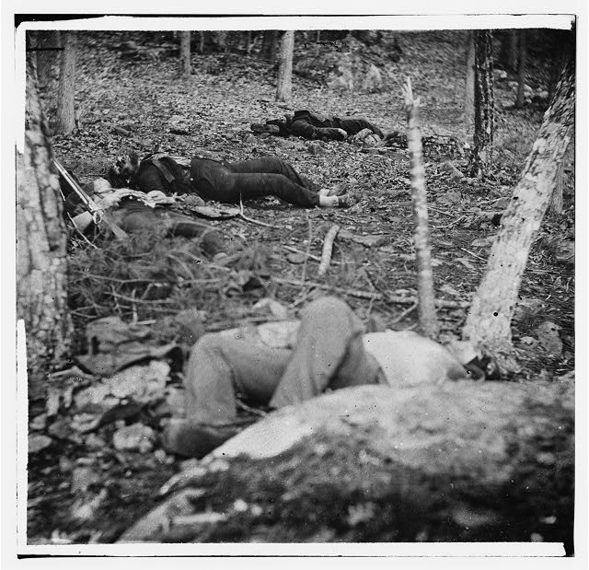
The world will little note nor long remember what we say here,
Image Source: http://www.loc.gov/pictures/resource/cwpb.00878/?co=cwp

Slide 16
but it can never forget what they did here.

Slide 17
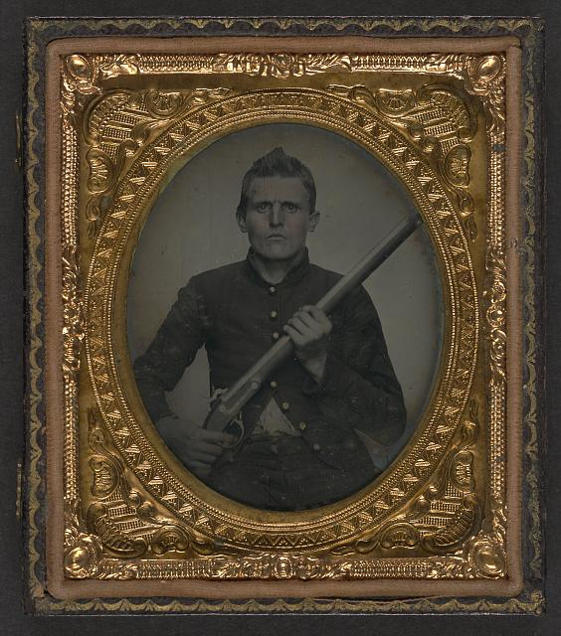
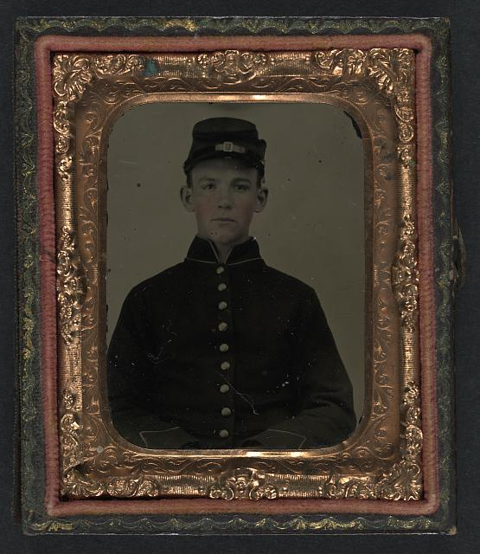
It is for us, the living, rather to be dedicated here
Image Source: http://www.loc.gov/pictures/resource/ppmsca.27018/?co=lilj
Image Source: http://www.loc.gov/pictures/resource/ppmsca.27353/?co=lilj

Slide 18
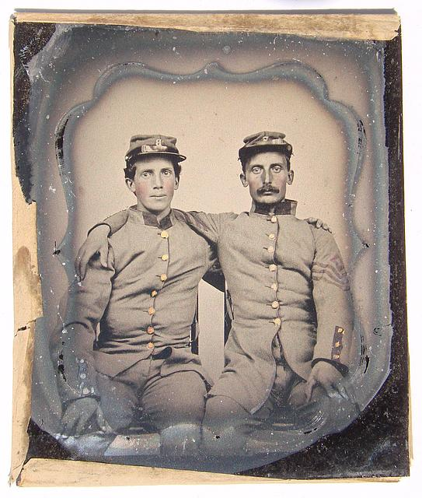
Image Source: http://www.loc.gov/pictures/resource/ppss.00284/?co=lilj
to the unfinished work which they fought here have thus far so nobly advanced.

Slide 19
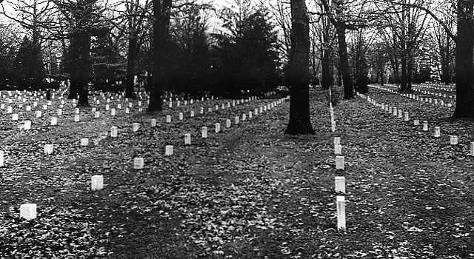
It is rather for us to be here dedicated to the great task remaining before us– from these honored dead
Image Source: http://farm4.static.flickr.com/3608/3360755074_376f8cee87_z.jpg?zz=1

Slide 20
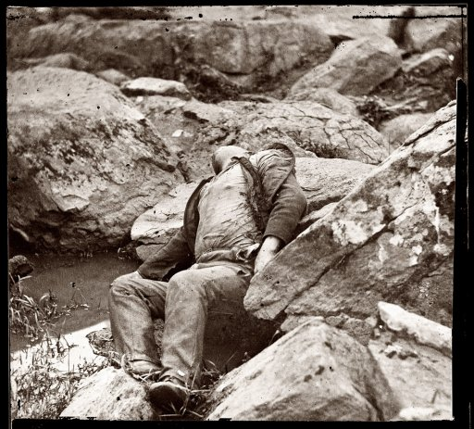
we take increased devotion to that cause for which they gave the last full measure of devotion--
Image Source: http://www.shorpy.com/files/images/00836u_0.preview.jpg

Slide 21
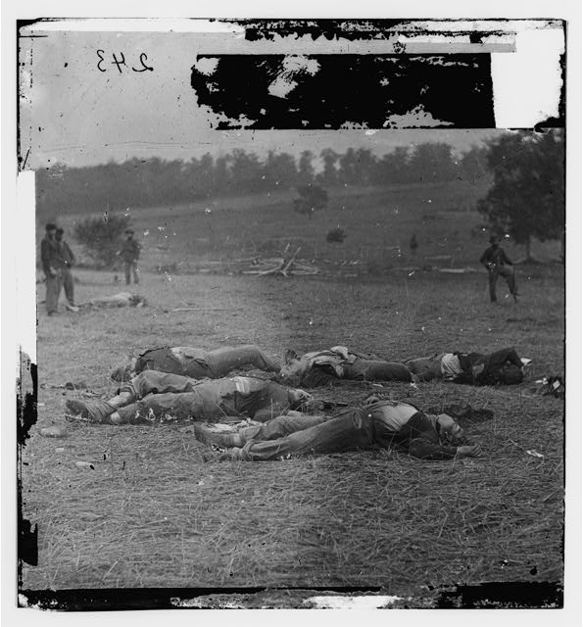
that we here highly resolve that these dead shall not have died in vain,
Image Source: http://www.loc.gov/pictures/resource/cwpb.00861/?co=cwp

Slide 22
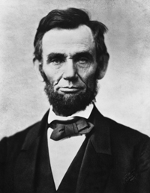
that this nation under God shall have a new birth of freedom,
Image Source:
http://www.catsafterme.com/wp-content/uploads/2009/06/al29.jpg
and that government of the people, by the people, for the people shall not perish from the earth.

